Slide 1
Genome Organization and Chromosomes
Dr. Shiromi Perera

Slide 2
Objectives
Describe how DNA is organized into chromosomes
Describe the structure of a chromosome
Explain the role of histone proteins in DNA packaging
Define the term Karyotyping and indicate its significances

Slide 3
Human Genome
Consists of
complex nuclear genome – More than 27,000 genes, partition between 23 different type of chromosomal DNA (22 autosomal, X,Y sex)
Simple mitochondrial genome – Only 37 genes
5% of human genome is highly conserved and presumably functionally important. Nearly 1% are protein coding genes.

Slide 4
DNA Organization In Eukaryotes
Human chromosomes about 19,000 to 73,000 microns in length
Total DNA about 2 meters long/cell
Nucleus about 5-10 microns in diameter
Condensation about 10,000X

Slide 5
Chromatin Structure
Chromosomal materials in the nucleus of cells of eukaryotic organisms
Eukaryotic DNA condensed with proteins and forms DNA- protein complex called chromatin
Chromatin Consists of
    DNA
    RNA
    Proteins : Histones (basic)
        Nonhistones (acidic)

Slide 6
Histones
  Small basic proteins
  Rich in basic amino acids Lysine and Arginine (20-30%)
  Forms ionic bond with negatively charged DNA
  Maintain the compacted structure of chromatin
  Five major types H1, H2A, H2B, H3, H4
  Except H1 others are called Core histones

Slide 7
Nonhistones
Enzymes in DNA replication and repair
Proteins in RNA synthesis, Processing and transport into cytoplasm

Slide 8
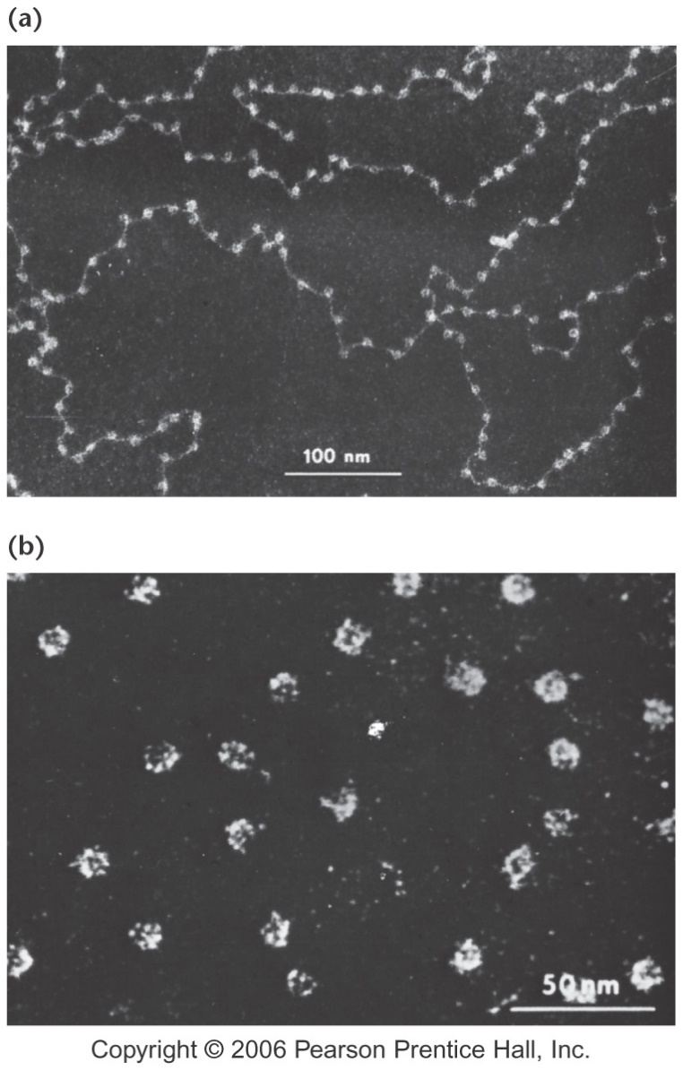
Chromatin Structure cont.......
EM Studies
Beads on a string
Originally called Nuclear bodies, now nucleosomes

Slide 9
Nucleosomes
Basic building block of eukaryotic chromatin structure
  Octamer of 2 each of H2A, H2B, H3 and H4
  About 147 bp of DNA wrapped around histone core particle
  Linker DNA between core particles is about 30-50 bp
  Histone H1 is on the outside at the point of DNA entry/exit to the core particle
Humans have about 25 million nucleosomes/cell

Slide 10
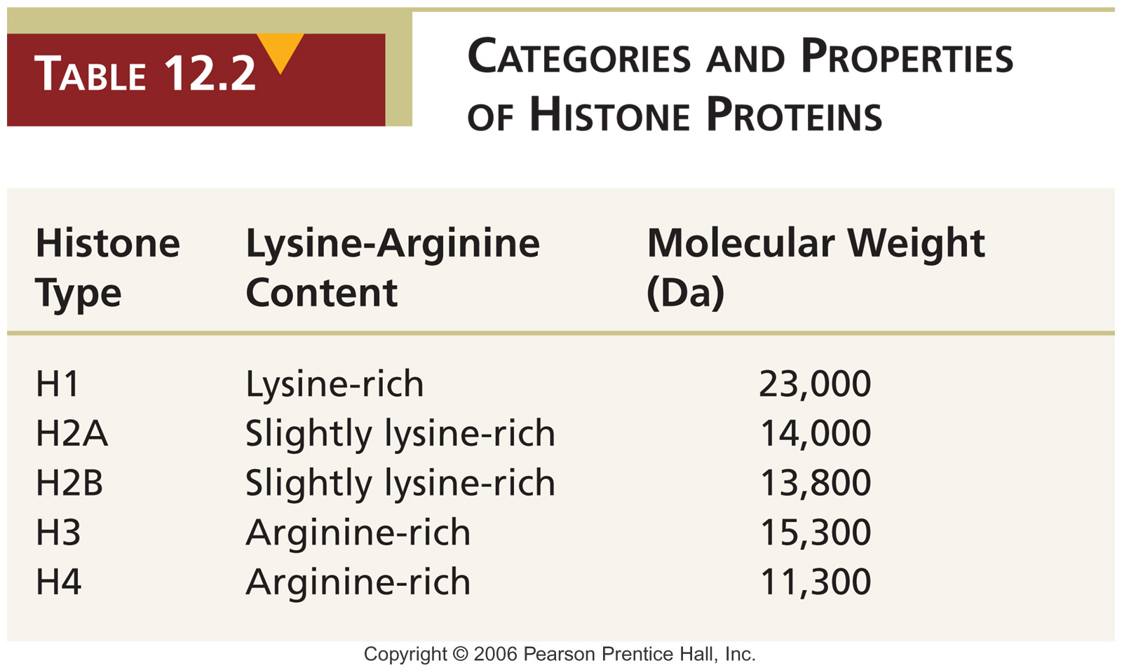

Slide 11
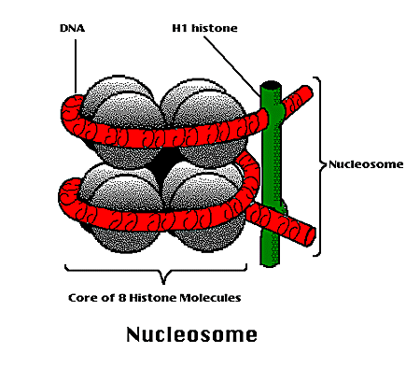
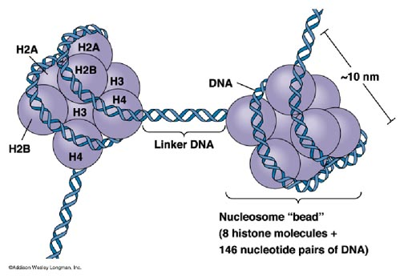
Nucleosome Structure
Very regular
Highly conserved
Can be crystallized for X-ray analysis

Slide 12
DNA Condensation
DNA duplex 2 nm in diameter
Nucleosome string about 10 nm in diameter
Nucleosomes form coiled solenoid-shaped fiber with 6 nucleosomes per spiral - 30 nm fiber
30 nm fiber then folded/looped to form 300 nm fiber
300 nm fibers coiled/folded to form 700 nm fiber that forms chromatid in meiosis/mitosis

Slide 13
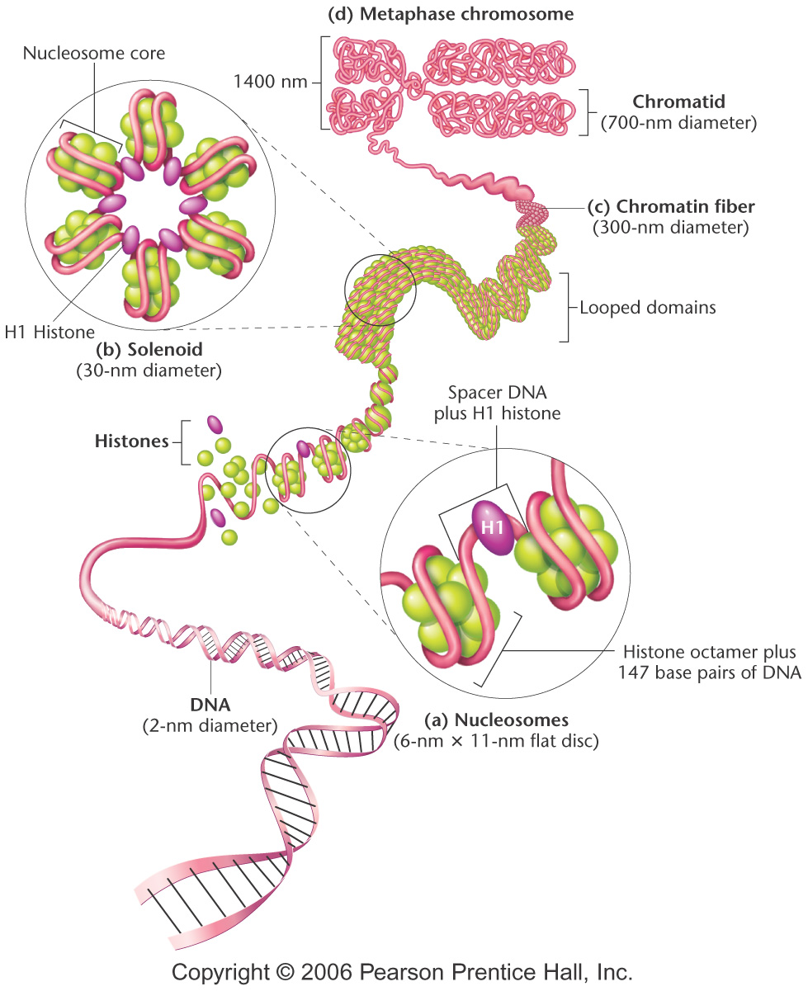
Levels of DNA Condensation
DNA
10 nm fiber
30 nm fiber
300 nm fiber
700 nm fiber

Slide 14
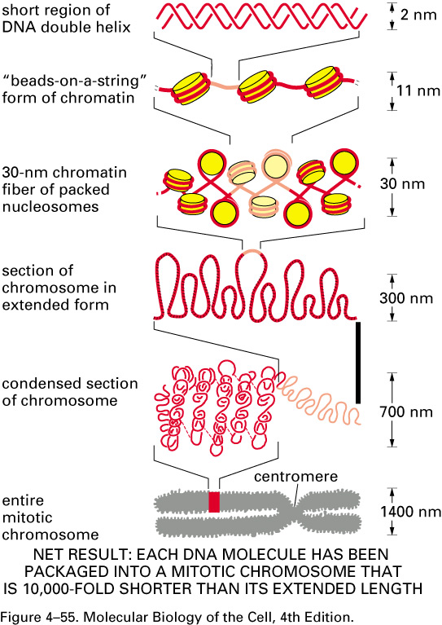
DNA packing simplified

Slide 15
Types of Chromatin
Staining differences in nuclei lead to terms
    Euchromatin
        Lightly staining
        Transcriptionally active
        Replicate early
    Heterochromatin
        Dark staining
        Transcriptionally inactive
        Replicates late in S phase

Slide 16
Chromatin Remodeling
Chromatin structure is dynamic
Induced change in chromatin structure
  Replication, gene expression
Histone modification
  Acetylation by histone acetyltransferase (HAT)
  Methylation by methyl transferases
  Phosphorylation by kinases
DNA modifications
  Methylation of cytosine (5-methyl C) in CpG islands

Slide 17
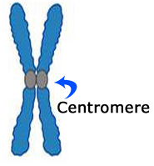
Structure of Chromosome
telomeres
short arm (p)
sister chromatid
long arm (q)
telomeres

Slide 18
Structure of Chromosome
Structure of Chromosome
Chromosome has two fold symmetry
Two sister chromatids connected through a centomere to form chromosome
Each sister chromatid contains one ds DNA molecule
Relative position of centomers differentiate chromosomes into four types

Slide 19
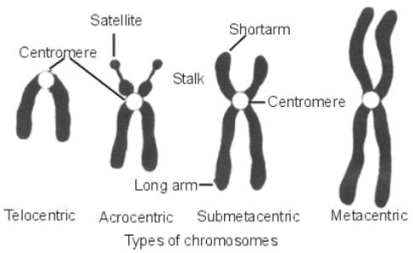
Structure of Chromosome
Metacentric
Submetacentric
Acrocentric
Telocentric

Slide 20
Structure of Chromosome
Non dividing stage of cell
  Packaging of DNA molecules is less dense in chromosomes – chromatin threads
Dividing stage of cell
  DNA in chromosomes tightly packed – visible chromosomes

Slide 21
Chromosomes in Somatic cells
46 chromosomes
44 autosomes 2 Sex
22 pairs
(homologous pairs) X Y
Diploid (2n)
XX XY Female Male

Slide 22
Chromosomes in germ line cells
23 chromosomes
22 autosomes 1 Sex
Sperm cell 22X or 22Y
Ova 22X
Haploid (n)

Slide 23
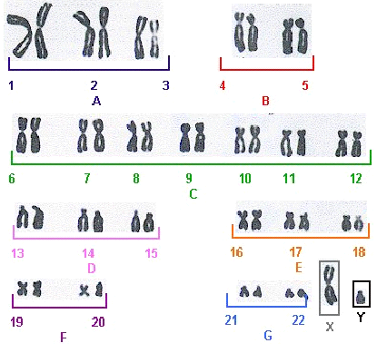
Karyotype
karyotype is an organized profile of a person's chromosomes
chromosomes are arranged and numbered by size, from largest to smallest

Slide 24
Karyotyping
Karyotyping is the process of pairing and ordering all the chromosomes of an organism
In karyotyping, scientists take a picture of someone's chromosomes, cut them out and match them up using size, banding pattern and centromere position

Slide 25
Karyograms use to Detect Chromosomal Abnormalities
can reveal changes in chromosome number
e . g. aneuploid conditions, such as trisomy 21 down syndrom
can reveal more subtle structural changes, such as chromosomal deletions, duplications, translocations

Slide 26
Chromosome Banding of Mitotic Chromosomes
C-banding
  Giemsa stain only stains centromeric regions
G-banding
  Trypsin treatment before Giemsa staining
  Provides a unique series of bands along each chromosome
  Provided uniform nomenclature for human chromosomes/locations in 1971

Slide 27
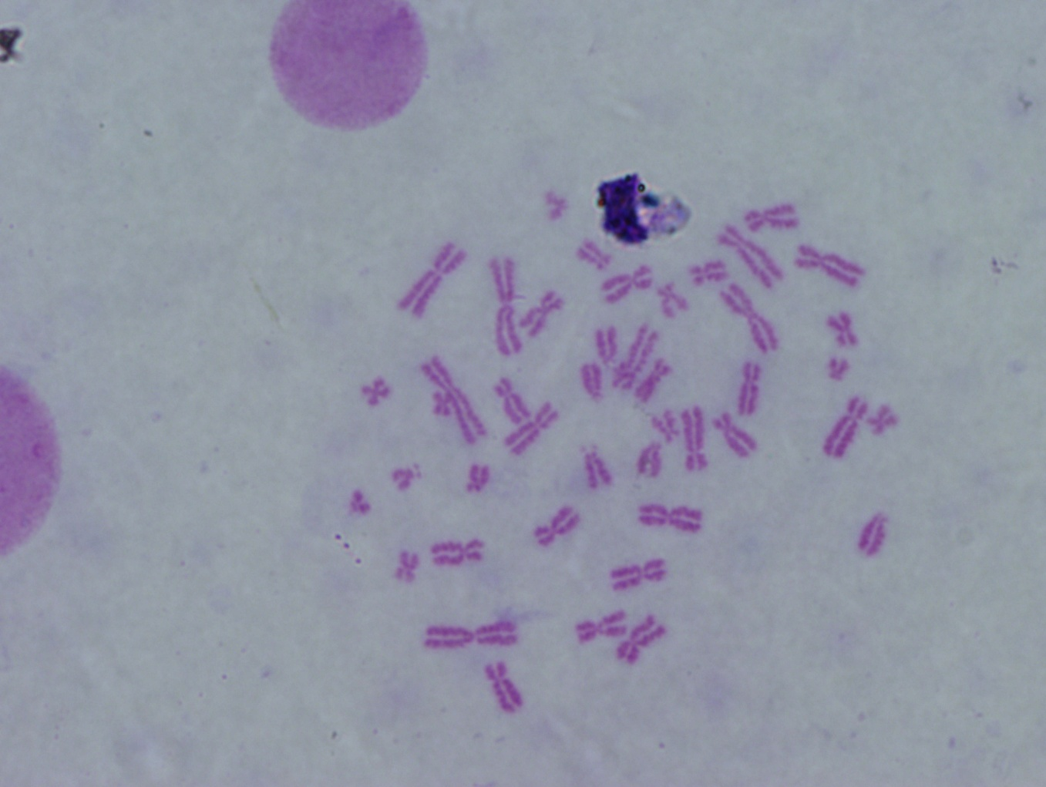
Chromosomal spread during metaphase (stained by Giemsa)
Centromere

Slide 28
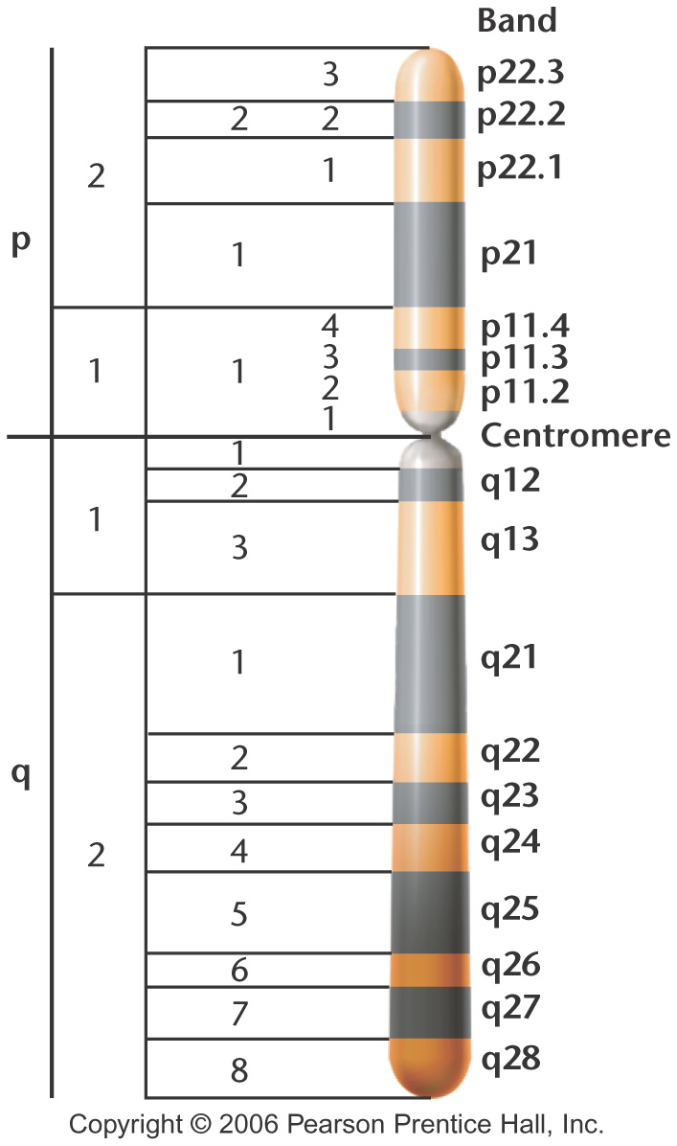
Banding Map of Human X Chromosome

Slide 29
Thank you

